Slide 1
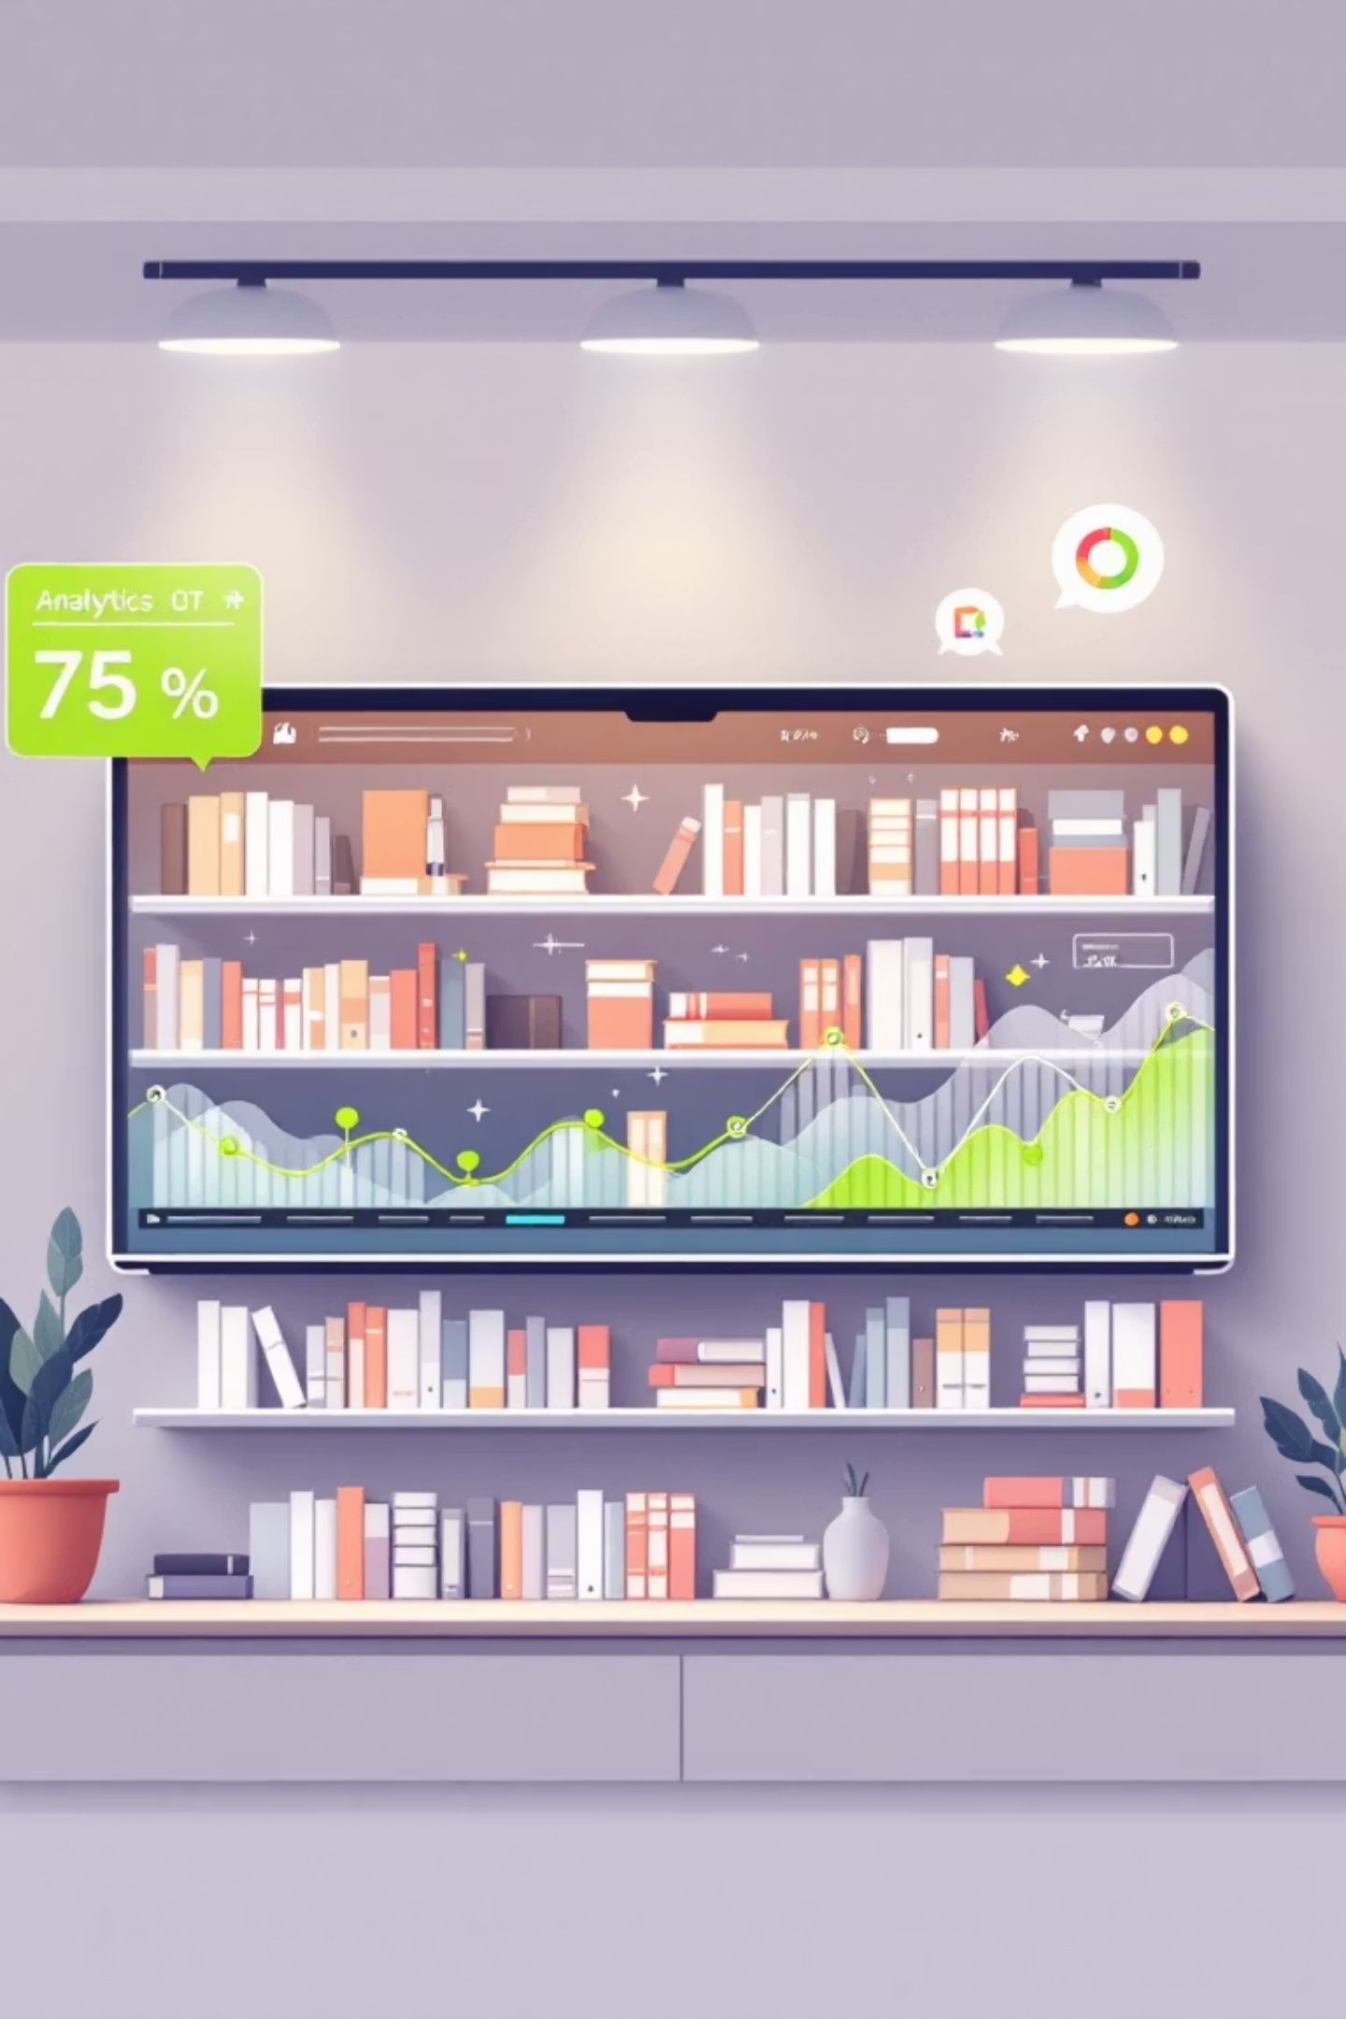
Online Bookstore Analysis
This report details an SQL-based analytical system for an online bookstore, aiming to enhance inventory visibility, customer understanding, and sales analysis.

Slide 2

Addressing Core Business Challenges
Inventory Visibility
Customer Understanding
Struggling with stockouts of high-demand books and overstocking low-demand ones.
Limited insights into purchasing behavior, loyal customers, and genre preferences.
Sales Monitoring
Lack of a centralized system for sales performance, revenue, and author contributions.

Slide 3
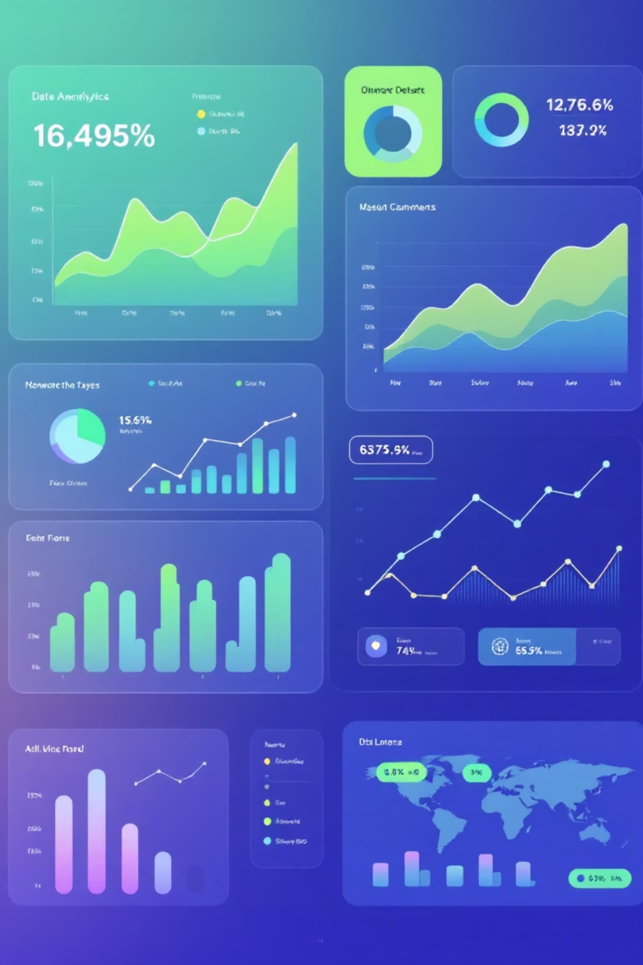
SQL-Driven Analytical Solutions
Track Stock Levels
1
Identify low-stock items and calculate remaining inventory after orders.
Analyze Sales Patterns
2
Understand buying behavior by genre, author, order frequency, and price.
Identify Revenue Trends
3
Spot high-spending customers and orders exceeding specific thresholds.
Insight into Performance
4
Highlight best-selling books, most expensive titles, and average prices.

Slide 4




Database Design
Our system uses structured tables to organize essential bookstore data.
Books Table
Customers Table
Stores book details, genre, price, and current stock levels.
Holds demographic information for all registered customers.
Orders Table
Tracks all purchases, quantities, total amounts, and order dates.

Slide 5
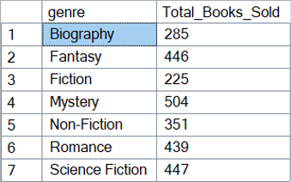

Genre-wise Books Sold
Mystery and Science Fiction lead in total books sold, indicating strong customer interest in these genres.

Slide 6

Top Authors & Most Expensive Books
Leading Authors by Sales
Highest Priced Books
Patrick Contreras: 28 books
Proactive system-worthy orchestration: $49.98
Melissa Taylor: 27 books
Emily James: 24 books
Optimized content-based standardization: $49.96
Thomas Trujillo: 24 books
Valerie Moore: 23 books
Stand-alone content-based hub: $49.90
Synchronized client-server service-desk: $49.89
Switchable modular moratorium: $49.88

Slide 7
Revenue Contribution by Book
Top books significantly drive overall revenue, highlighting their importance.
120
Integrated secondary access
1104.69
1.46
142
Multi-tiered responsive parallelism
1077.12
1.42
119
Switchable modular moratorium
1047.48
1.39
471
Cross-platform next generation website
952.98
1.26
422
Grass-roots systematic moderator
872.29
1.15

Slide 8
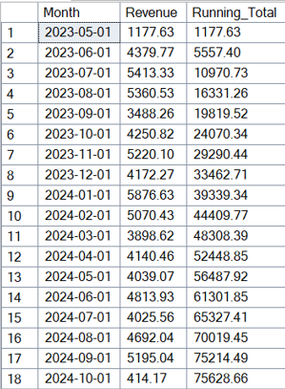

Customer Lifetime Value & Monthly Revenue
Top Customers by Lifetime Value
Monthly Revenue Trends
Kim Turner: $1398.90
Revenue shows consistent growth with predictable peaks, especially from January to September.
Jonathon Strickland: $1080.95
Carrie Perez: $1052.27
Julie Smith: $991.00
Pamela Gordon: $986.30

Slide 9

Inventory Optimization & Best Sellers
1
Remaining Stock
Several books show negative remaining stock, indicating urgent need for restocking.
Pre-emptive intangible adapter: -18
Expanded local infrastructure: -16
Re-contextualized real-time Graphic Interface: -14
2
Best-Selling Books
Top-ranked books by sales volume should be prioritized for inventory and promotion.
Book ID 73: 28 sold
Book ID 31: 27 sold
Book ID 157: 24 sold

Slide 10


Key Business Recommendations
Optimize Inventory
Targeted Promotions
Stop overstocking slow-moving genres; reallocate budget to high-sales genres.
Push high-margin authors/books; reprice underperforming expensive books.
Customer Loyalty
Data-Driven Decisions
Target high-value customers with loyalty perks; reward consecutive monthly purchasers.
Restock based on actual sales data; aggressively promote top-selling books.

